Slide 1
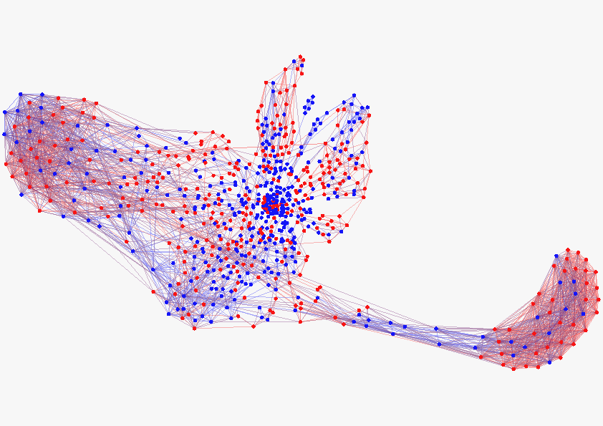



Information and Opinion Dynamics in Online Social Networks
Presented By: Niloy Ganguly, Department of Computer Science
CNeRG IIT Kharagpur
iitkgpcnerg
@cnerg
www.cnerg.org

Slide 2



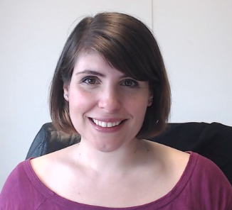

Collaborators
Sourangshu Bhattacharya
Abir De
Bidisha Samanta
Isabel Valera
Manuel Gomez Rodriguez

Slide 3



Activities over Social Network and Social Media
Events are observations of complex dynamic process
Product reviews and sales in Amazon
News spread in Twitter
A user gains recognition in Quora
Video becomes viral in Youtube
Posts on several events becomes viral

Slide 4
Events are observations of complex dynamic process
Complex
interactions
Temporal as well as contextual
Diffusion
Information propagation
Opinion propagation
Deals with only
temporal data
Deals with content as well as temporal data

Slide 5
Accurate Modelling
Accurate Forecasting
Understanding which pieces of information are getting through and which are ignored
Challenges to understand the diffusion process

Slide 6
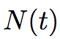
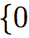

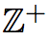
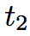
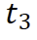
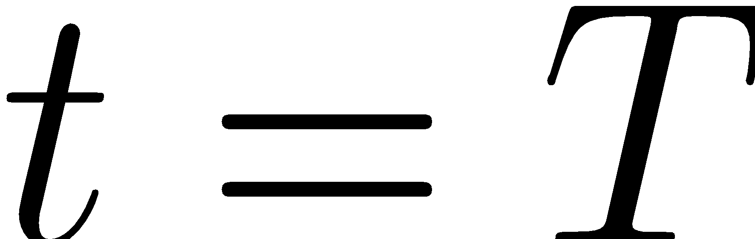
Mathematical device to capture the diffusion process
Models arrival rate of different process
Temporal Point Process
Captures various phenomenona of interest like text
time
History,

Slide 7
What is a temporal point process ?
A random process whose realization consists of discrete events localized in time

Slide 8

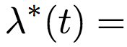
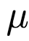
Poisson Process
time
Intensity of a Poisson process
Observations:
Intensity independent of history
Uniformly random occurrence
Time interval follows exponential distribution

Slide 9
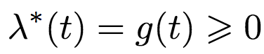
Inhomogeneous poisson process
time
Intensity of an inhomogeneous Poisson process
Observations:
Intensity independent of history

Slide 10
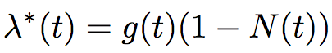
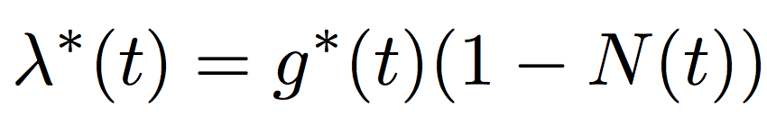
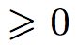
Terminating (or survival) process
time
Intensity of a terminating (or survival) process
Observations:
Limited number of occurrences

Slide 11
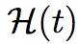
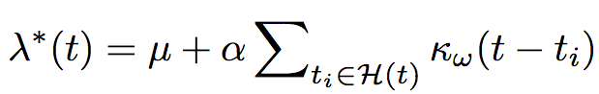
Hawkes Process
time
History,
Triggering kernel
Intensity of self-exciting (or Hawkes) process:
The effect of the history

Slide 12
Two important problems in information diffusion
Hashtag Diffusion (Temporal)
[INFOCOM’17, IJCAI’17]
Opinion dynamics (Data driven and Temporal)
[NIPS’16][ICDM’17]

Slide 13
Hashtag Diffusion in social media
IJCAI’17, Infocom’17

Slide 14
Hashtag diffusion in social media - is it new?
Temporal Model
Feature engineering
(Rosenfeld et al WSDM ’16, Bourigault et al WSDM’14)
Notes:
Hashtag diffusion models are of two types. 1. Fetaure based: Rely on offline

Slide 15
Drawbacks of existing models
Reinforced Poisson Process (RPP) AAAI’14
Model single tweet propagation dynamics
Model gives a non-convex objective function
Hawkes Process based models
(Hawkes, Seismic)
WWW’15, KDD’15
Model single tweet propagation dynamics
Some variation of this model is limited to long term forecasting
Pattern based models
(spikeM) WWW’15
Heavily dependent on users’ past activities (6 pattern of spikes)
Model fails if user activity changes frequently

Slide 16
Realistic Scenario
Hashtag is a heterogenous collection of tweets
Hashtag reflects a story better

Slide 17
Hashtag is a collection of tweet-chains
dN_{T1}(t)
dN_{T2}(t)
dN_{T3}(t)
dN_{H}(t)
Time(t)

Slide 18
Hashtag diffusion in social Media
Real world reinforcement factors
Intra-hashtag
Hashtag-tweet reinforcement
Inter-hashtag
Hashtag-hashtag competition

Slide 19
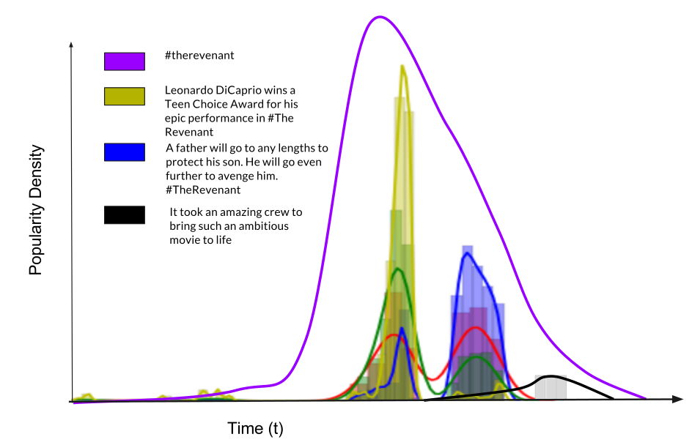
Some example from the real data

Slide 20
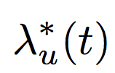
Hashtag-tweet reinforcement
Unpopular tweets
dN_{T1}(t)
dN_{T3}(t)
Popular tweets
Hashtag propagation
dN_{H}(t)
New tweets
dN_{T4}(t)
Time(t)

Slide 21
Inter-hashtag competition
Time window
N1 > N2
N1 < N2
N1 = N2
N1 > N2
Hashtag popularity distribution
Time(t)

Slide 22
LMPP (Large Margin Point Process)
Constrained likelihood Estimation
(Constrained MLE)
Competition Modeling
Likelihood calculation
Hashtag tweet Reinforcement modeling
Arrival Rate estimation
(Point Process)

Slide 23
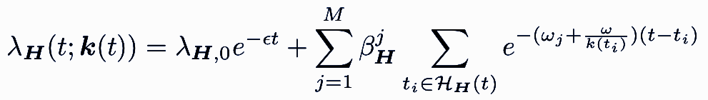
Arrival rate formulation
Likelihood estimation
Model competition as constraint
Parameter estimation
Future arrival rate estimation
Arrival rate formulation (Hawkes process) captures the tweet reinforcement
time
History
Popularity index
Triggering kernel
Effect of the previous history
Background rate

Slide 24
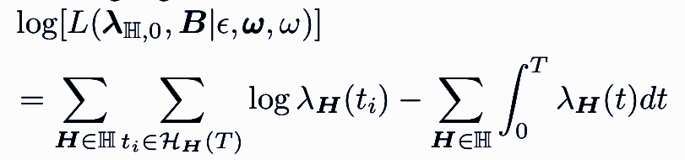
Arrival rate formulation
Likelihood estimation
Model competition as constraint
Parameter estimation
Log likelihood of observing events till time T
Parameters of the model we want to derive

Slide 25
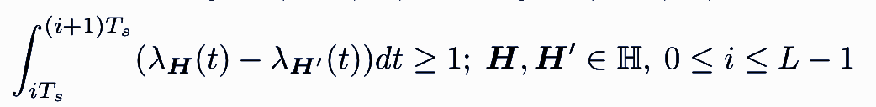
Arrival rate formulation
Likelihood estimation
Model competition as constraint
Parameter estimation
Future arrival rate estimation
Difference in total number of posts corresponding to two hashtags when N_H > N_H’
N_H > N_H’
Time window
(L)
N_H < N_H’
N_H = N_H’
N_H > N_H’

Slide 26

Dataset
Oscars: 2016 Academy Award ceremony, data collected from Feb 24 to Feb 29, 2016.
#leonardodicaprio,#bearstory
Dem-Primary: Campaign for Hillary Clinton for USA election. Data collected from Feb to June, 2016. #nohillary #standwithhillary
MTV-Awards: 2016 MTV Award Star program, collected from April 3 to April 12, 2016. #mtvawardsstar
Nepal-earthquake: Earthquake in Nepal, from April 25 to May 1, 2015. ,#nepalrelief #helpnepal
BBD: Bigbillionday sale of Flipkart India, from October 6 to October 8, 2014. #bigbillionsale
Copa: Copa America Football tournament, from June 3 to June 26, 2016 #copaamericaentd, #aocopa
TWC20: ICC World Cup T20, India, from March 8 to April 3, 2016 #indvspak #indvsban

Slide 27
Evaluation protocol
Forecasting hashtag popularity
Learn the model parameters and forecast
Rank prediction of competing hashtags
Predicting jump in rank

Slide 28
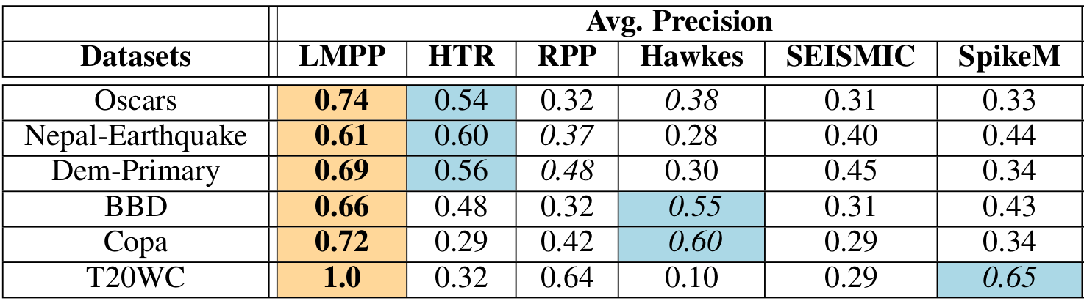
Results for jump prediction
JUMP A sudden change in position in the rank-list by
LMPP outperforms other methods however there is no clear 2nd best

Slide 29
Learning Opinion Dynamics in Social Networks
NIPS’16

Slide 30

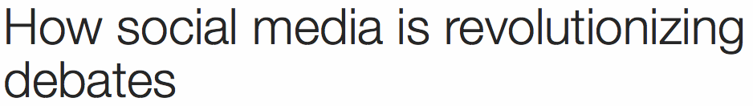



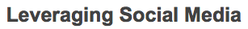
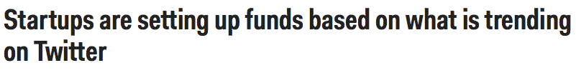

Opinions in Social media
People’s opinion about political discourse
Investors’ sentiment about stocks
Brand sentiment and reputation
30
Notes:
`Today people express their opinion in social media in various topics – for example political issues, investors stock, product reviews etc. Hence Social Media has become a platform for sensing granular opinion

Slide 31
Opinion modeling in social media - is it new?
There are a lot of theoretical models of opinion dynamics, but…
Updated in discrete time
Do not distinguish between latent and expressed opinions
Difficult to learn from data
Focus on steady state, neglecting transient behavior

Slide 32
Difference with the hashtag diffusion model
User interaction graph
Utilizing text of the message (sentiment)

Slide 33




Key Idea: Temporal and Informational influence
Bob
Joe
opinion
Alice
Charlie
Alice is highest temporal influence
Bob
Joe
opinion
Alice
Charlie
Joe has highest informational influence

Slide 34
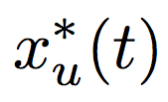
Model Formulation
Learning opinion dynamics (SLANT)
Difference between the Hashtag and Opinion Dynamics Modeling
Previous Model
Current Model
Intensity of the arrival
Opinion

Slide 35
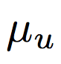
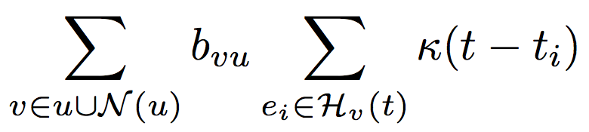
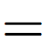
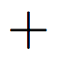
Simulation and Estimation
Real-data (Experiment
Learning opinion dynamics (SLANT)
Model intensity of the messages
Exponential kernel (memory)
User’s message intensity
Messages on her own initiative
Temporal influence from user v on user u
Previous messages by user v

Slide 36
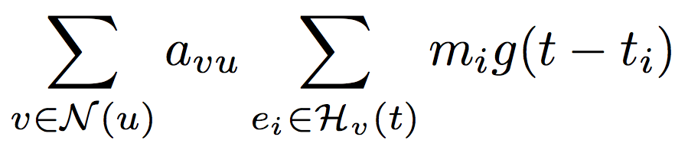
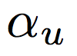
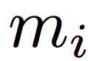

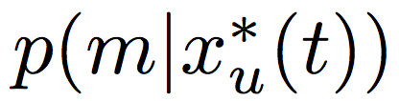
Simulation and Estimation
Real-data Experiment
Learning opinion dynamics (SLANT)
Stochastic Process for opinions
Exponential kernel (memory)
User’s latent
opinion
User’s initial opinion
Informational influence from user v on user u
Not captured previously
Previous expressed opinions y user v
x_{Alice}(t)
<0, disagree
Bob
Charly
>0, agree
a_{Charly,Alice}m₂
Alice
α_{Alice}
a_{Bob,Alice}m₁
Sampled from the latent opinion
m(t)
m₃
m₁
m₂

Slide 37
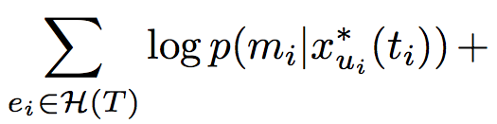
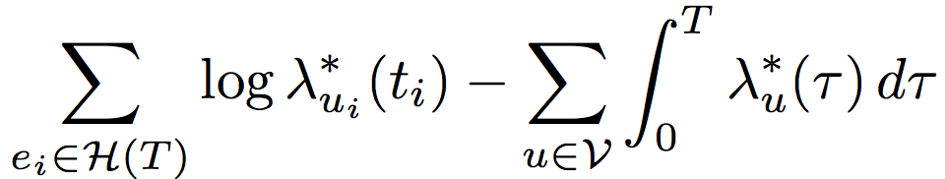
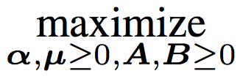
Model Formulation
Simulation and Estimation
Real-data Experiment
Learning opinion dynamics (SLANT)
Efficient parameter estimation using MLE
Find optimal parameters using maximum likelihood estimation (MLE):
Message sentiments
Message times
For a large class of sentiment distributions, the MLE problem is parallelizable and convex.
Markov property allows us to compute sums and integrals in linear time!

Slide 38
Model Formulation
Simulation and Estimation
Real-data Experiment
Real Data Experiments
Delhi Assembly Election, 12/2013
The Avengers: Age of Ultron, 05/2015
Mayweather vs Pacquiao, 05/2015
Bollywood star incident, 05/2015
US elections, 04/2016

Slide 39
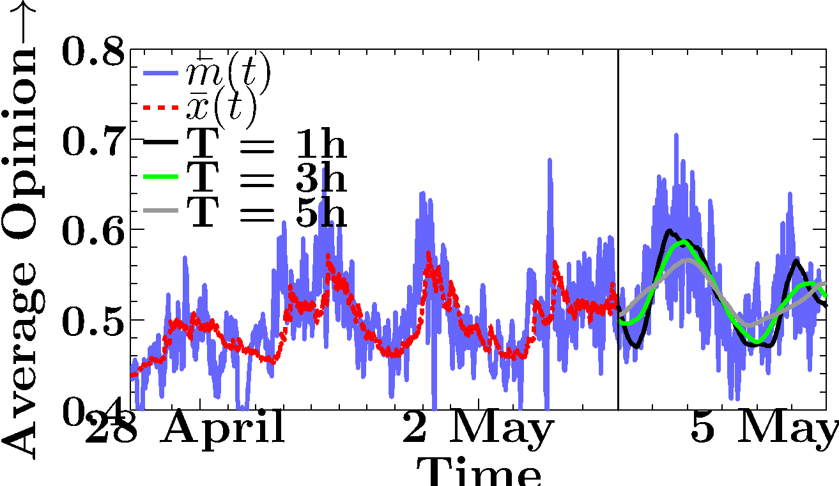
Model Formulation
Simulation and Estimation
Real-data Experiment
Real Data Experiments
Macroscopic Forecasting
The Avengers: Age of Ultron, 05/2015
The forecasted opinion becomes less accurate as T increases, as one may expect.

Slide 40
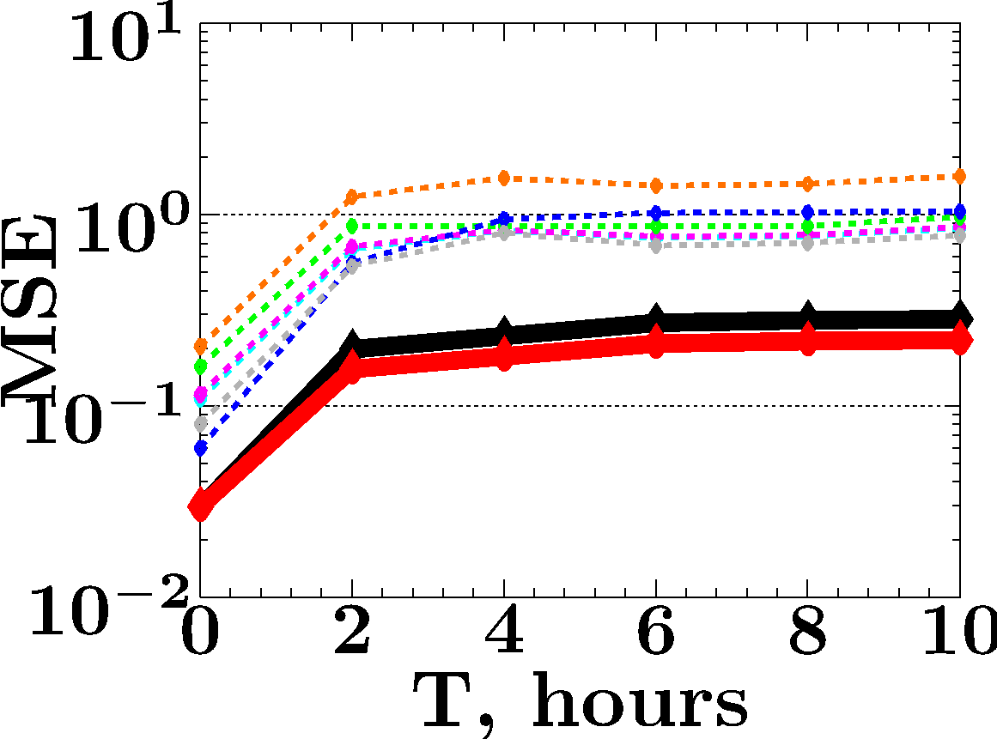
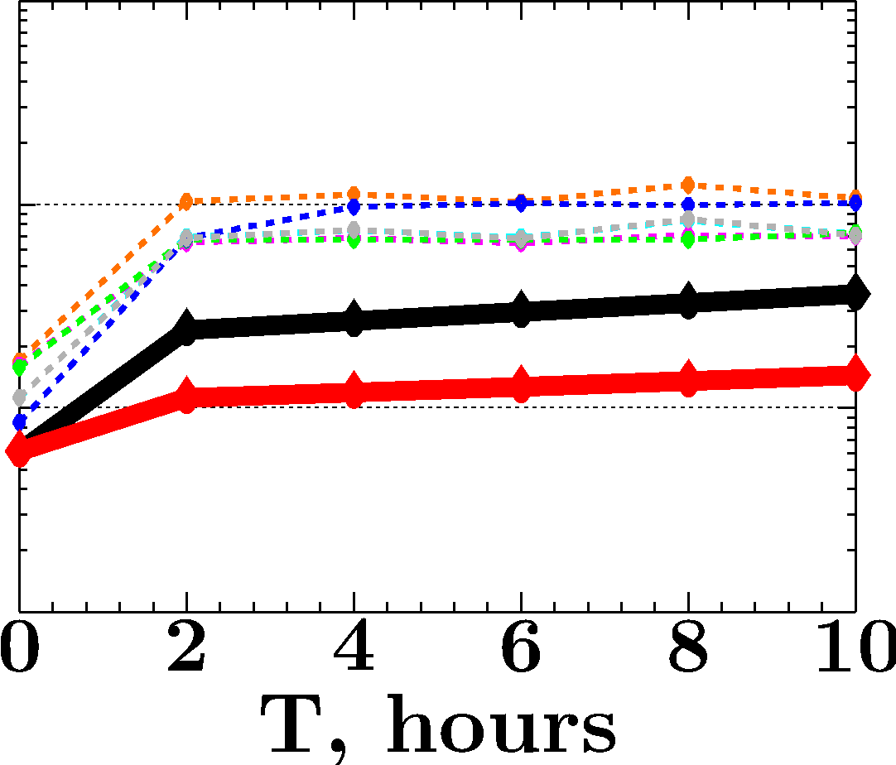
Simulation and Estimation
Real Data Experiments
Microscopic forecasting, MSE
Delhi Assembly Election, 12/2013
US elections, 04/2016
Our model (in red) outperforms state of the art in terms of MSE , often by orders of magnitude

Slide 41
Learning Nonlinear Opinion Dynamics in Social Networks
ICDM 17

Slide 42
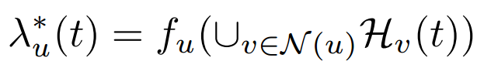
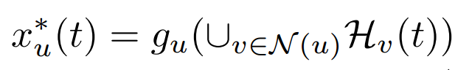
SLANT+: A nonlinear departure from SLANT
SLANT
SLANT+
Informational
Influence
Coupling
Nonlinear Modeling
Coupling
Fixed, linear, semi-coupled
Set of past events
Temporal
Influence
Nonlinear Modeling
Notes:
So we propose here to have a generalized model of SLANT called Deep-SLANT. Here we don’t assume any fixed representation of the function of f and g.

Slide 43
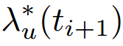
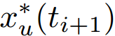
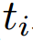
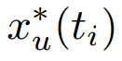
SLANT+: An intuitive approach
Capturing nonlinearity via
recurrent neural network
,
Coupling
A single RNN for
whole network
Small RNNs
per user
1. Expressivity issues
1. Explainable
2. Decentralized
,
2. Training issues
RMTPP, Du et al. 16, In KDD 2016

Slide 44
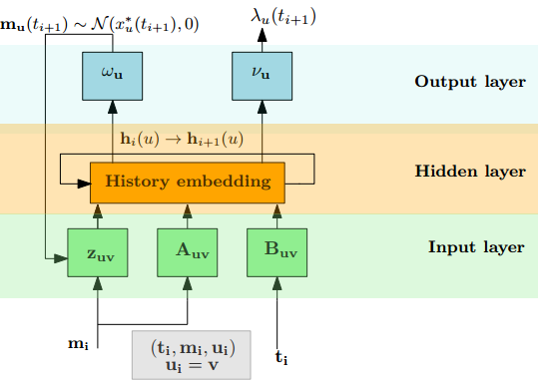
Nonlinear Modeling: A networked guided RNN approach
Opinion and
message generation
Embedding history:
captures coupling
Coupling
Temporal
Influence
Capturing Influence dynamics
Informational
Influence
RNN for user u
Notes:
Explanation for the non-linear approximations which can help using deep architecture for small amount of learning data

Slide 45
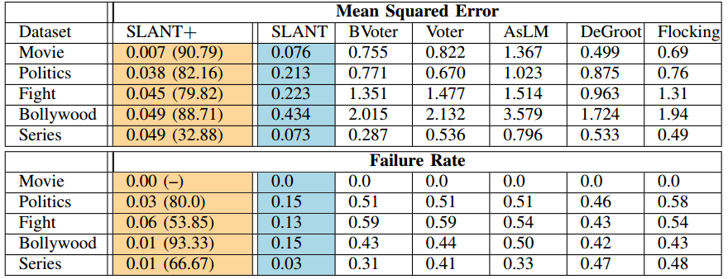
Experimental Results
Notes:
http://barabasi.com/f/250.pdf

Slide 46
Summary
Generalised framework that captures popular dynamics on social media
Besides modeling, rigorous experimentation over diverse set of data shows the performance at critical junctions are significantly better

Slide 47
Subprocesses in information and opinion dynamics
Consists of complex Subprocesses
Consists of different users
Endogenous &
Exogenous process
Organic &
Extrinsic users

Slide 48
Demarcating Endogenous and Exogenous Opinion Diffusion Process in Social Networks
WWW 18

Slide 49
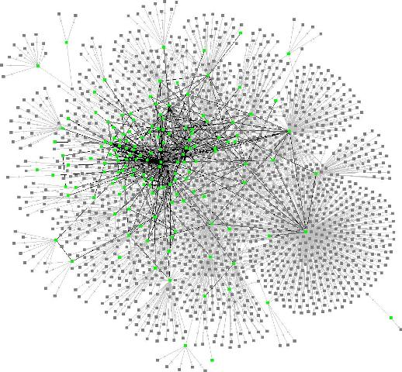
Opinion dynamics….
Initiated by sociologists and physicists
Voter Model (Clifford and Sudbery 1973, Cox 1991, etc. )
DeGroot Model (DeGroot, 1974)
Data driven models
Biased Voter Model (Das et al 2014)
Linear Model (De et al 2014)
SLANT, SLANT+ (De et al 2016, 2017)
Notes:
The research on opinion dynamics got a fresh lease with the advent of onlines social networks, specially from data driven perspective.
very recently there are few sets of models For example biased voter model in 2014 and then Linear Models like AsLM and then SLANt.

Slide 50
The modus operandi….
Alice
Bob
David
Charlie
Users’ opinions are influenced by neighbors
Notes:
In each of plethora of models, the underlying premise remained similar. There is a network of users and the user is influenced by here neighbors.
So for example here Alice is connected to Bob, Charlie and David to whom they are following. Alice has some intial opinion in a discussion, it keeps changing as it is exposed
to either of her friends.

Slide 51
Reality
endogenous
exogenous
Alice
Bob
David
Charlie
Users also express opinions gathered from external sources
Notes:
However, the reality is different. An user in reality is not exposed to only her nbrs, but also to the other sources of information.
For example, she may read some news, some external source etc. So, in practice she would express opinions that are gathered from external sources. So we see there is a clear demarcation between opinions--endo

Slide 52
Reality
endogenous
exogenous
Alice
Bob
David
Charlie
Existing models strive to capture externalities
Users also express opinions gathered from external sources
Notes:
Despite such a rich literature, the existing models strive to capture the externalities.. Its not that they don’t acknowledge them.
But they take care of them by adding an odd constant to offset them.

Slide 53
Why externalities have been a big challenge for data-driven models?

Slide 54
The roadblocks
Messages are unlabeled
No supervised techniques work
??

Slide 55
A simple solution…
Content based clustering
??
Notes:
If you look carefully, these opinions change with time. For example, if you have an opinion on some topics, it may change after you read an informative article about it.

Slide 56
A simple solution…
Content based clustering
??
Alice: NY Times hints at a new trade war
A timely article in NY Times…..
Notes:
If you look carefully, these opinions change with time. For example, if you have an opinion on some topics, it may change after you read an informative article about it.

Slide 57
A simple solution…
Content based clustering
??
Alice: NY Times hints at a new trade war
Same content can be endogenous and exogenous
A timely article in NY Times…..
Notes:
If you look carefully, these opinions change with time. For example, if you have an opinion on some topics, it may change after you read an informative article about it.

Slide 58
Our work..
Alice
Bob
??
David
Charlie
Can we demarcate endogenous and exogenous messages
Notes:
If you look carefully, these opinions change with time. For example, if you have an opinion on some topics, it may change after you read an informative article about it.

Slide 59
Models for endogenous dynamics
Voter model
Clifford et al 1973
Degroot model
DeGroot et al 1974
Asynchronous linear model
De et al 2014
SLANT
De et al 2016
Notes:
If you look carefully, these opinions change with time. For example, if you have an opinion on some topics, it may change after you read an informative article about it.

Slide 60
SLANT
Alice
Bob
David
Charlie
Notes:
If you look carefully, these opinions change with time. For example, if you have an opinion on some topics, it may change after you read an informative article about it.

Slide 61
SLANT: Parameter estimation
MLE
Notes:
If you look carefully, these opinions change with time. For example, if you have an opinion on some topics, it may change after you read an informative article about it.

Slide 62
Reality
MLE
Notes:
If you look carefully, these opinions change with time. For example, if you have an opinion on some topics, it may change after you read an informative article about it.

Slide 63
Reality
MLE
Poor estimation
Notes:
If you look carefully, these opinions change with time. For example, if you have an opinion on some topics, it may change after you read an informative article about it.

Slide 64
Reality
MLE
Poor estimation
Can we use this simple fact to demarcate the endogenous and exogenous messages
Notes:
If you look carefully, these opinions change with time. For example, if you have an opinion on some topics, it may change after you read an informative article about it.

Slide 65
Setup
MLE
Notes:
If you look carefully, these opinions change with time. For example, if you have an opinion on some topics, it may change after you read an informative article about it.

Slide 66
Setup
MLE
Training different gives different estimates
Notes:
If you look carefully, these opinions change with time. For example, if you have an opinion on some topics, it may change after you read an informative article about it.

Slide 67
The core problem
MLE
Which subset should be chosen?
Notes:
If you look carefully, these opinions change with time. For example, if you have an opinion on some topics, it may change after you read an informative article about it.

Slide 68
The core problem
MLE
Which subset should give best possible
Notes:
If you look carefully, these opinions change with time. For example, if you have an opinion on some topics, it may change after you read an informative article about it.

Slide 69
The core problem
MLE
Which subset should give
least variance of
Notes:
We consider variance to measure the quality of estimation.

Slide 70
The core problem
MLE
Linear models allow us to compute closed form variance of
Notes:
If you look carefully, these opinions change with time. For example, if you have an opinion on some topics, it may change after you read an informative article about it.

Slide 71
CherryPick
Submodular in
Notes:
We assumed fixed form of the arrival rate. How to model a more generic model using deep framework to capture any form of nonlinearity?

Slide 72
CherryPick
Greedy approach gives approximation guarantee
Submodular in
Notes:
We assumed fixed form of the arrival rate. How to model a more generic model using deep framework to capture any form of nonlinearity?

Slide 73
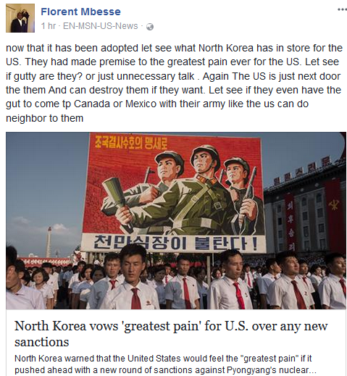

Organic and Extrinsic Users
Extrinsic: Influenced more by externalities
Alice
Joe
Organic: Influenced more by other users
Bob
Charlie
Exogenous opinions
Endogenous opinions

Slide 74

Summary of the approach..
74
Notes:
We assumed fixed form of the arrival rate. How to model a more generic model using deep framework to capture any form of nonlinearity?

Slide 75
Experiments
Notes:
We assumed fixed form of the arrival rate. How to model a more generic model using deep framework to capture any form of nonlinearity?

Slide 76
Evaluation protocol
opinion
Improvement on prediction
Train
Predict
Notes:
We assumed fixed form of the arrival rate. How to model a more generic model using deep framework to capture any form of nonlinearity?

Slide 77
Evaluation protocol
opinion
Improvement on prediction
Train
Predict
opinion
Parameters
Notes:
We assumed fixed form of the arrival rate. How to model a more generic model using deep framework to capture any form of nonlinearity?

Slide 78

Datasets
Bollywood
Sports
Series
Verdict
US elections
Notes:
We assumed fixed form of the arrival rate. How to model a more generic model using deep framework to capture any form of nonlinearity?

Slide 79
Comparative Analysis
MSE:
FR:
Elections
0.146
0.193
0.073
0.098
Series
0.110
0.213
0.097
0.125
Verdict
0.060
0.090
0.057
0.073
Notes:
We assumed fixed form of the arrival rate. How to model a more generic model using deep framework to capture any form of nonlinearity?

Slide 80
Impact of pre-specified size on
SLANT
SLANT
Verdict datasets
Notes:
We assumed fixed form of the arrival rate. How to model a more generic model using deep framework to capture any form of nonlinearity?

Slide 81
Examples from US Election dataset
Exogenous
#BREAKING: [..] campaign manager
will not be prosecuted. A total joke.
Sad! [..], quit your whining
Endogenous
[..] campaign manager won’t be
prosecuted. Such a huge disaster. :
Endogenous
[…] shows farsightedness by
shaking hands with Russia..
Exogenous
Notes:
We assumed fixed form of the arrival rate. How to model a more generic model using deep framework to capture any form of nonlinearity?

Slide 82
Effect of extrinsic user identification
Wang et al. ICML 2017
Notes:
We assumed fixed form of the arrival rate. How to model a more generic model using deep framework to capture any form of nonlinearity?

Slide 83
Conclusion
Models for information and opinion dynamics
Capture the external effects
Control the opinion dynamics
Notes:
We assumed fixed form of the arrival rate. How to model a more generic model using deep framework to capture any form of nonlinearity?

Slide 84

Complex Network Research Group (CNReG)
iitkgpcnerg
Thank You
@cnerg
www.cnerg.org

Slide 85
Shaping Opinion Dynamics in Social Networks
AAMAS 18

Slide 86


Shaping opinion dynamics
Can a small set of incentivized users shape other users’ opinions?
Why this goal?
Brand management
Awareness on orchestrated campaigns

Slide 87
Our goal
Steady state opinion control
Find optimal incentivized users
Compute the optimal message rate of the control users
Robust opinion shaping

Slide 88



Steady state shaping
Control:
-- the steady state opinion of “non incentivized” user
Select the control nodes

Slide 89

Differential dynamics
Influence among
non-control users
Influence of
control users on
the network
Message rates for positive
and negative opinions

Slide 90

Steady state opinion
Influence of
control users on
the network
Influence among
non-control users
Message rates for positive
and negative opinions

Slide 91


In terms of “unknown” incentivized users
One hot representation of Incentivized users

Slide 92





Activity shaping problem
Once we know that
we can find and to satisfy many different goals:
Opinion Shaping Problem
We can solve this problem efficiently for a large family of utilities!
Utility (Goal)
Sentiment value
Cost for incentivizing
Budget

Slide 93


SmartShape-Basic
Steady state
characterization
So that,
Budget constraint
Well posed rate

Slide 94
SmartShape-Basic
MIP
Non convex

Slide 95
SmartShape-Basic
Linearization of variables
MIP
Non convex

Slide 96


Linearization of variables
Francisco E Torres. Linearization of mixed-integer products. Mathematical programming, 49(1):427–428, 1990

Slide 97

SmartShape-Basic

Slide 98

SmartShape-Robust

Slide 99




Examples of utility U(.)

Slide 100


Top-k-opinion-shaping
= i-th largest component of y

Slide 101


Experiments on Politics dataset
MMOSH-1
Top-k-OSH-1

Slide 102



Experiments on SmartShape-Robust
MMOSH-1
Top-k-OSH-1

Slide 103


Experiments on SmartShape-Robust
Top-k-OSH-1
Objective variation
Variance variation

Slide 104

Characterization of incentivized users
Movie dataset
Overlap= Jaccard Coefficient

Slide 105
Conclusion
Models for information and opinion dynamics
Capture the external effects
Control the opinion dynamics
Notes:
We assumed fixed form of the arrival rate. How to model a more generic model using deep framework to capture any form of nonlinearity?

Slide 106
Few points to work in future
How to capture competition via an deep adversarial network?
Opinion regulation through deep learning
Demarcation with partial labels
Notes:
We assumed fixed form of the arrival rate. How to model a more generic model using deep framework to capture any form of nonlinearity?

Slide 107
Complex Network Research Group (CNReG)
iitkgpcnerg
Thank You
@cnerg
www.cnerg.org

Slide 108
Thank You

Slide 109
Accepted papers
Bidisha Samanta, Abir De, Abhijnan Chakrabarti, Niloy Ganguly, LMPP: A Large Margin Point Process Combining Reinforcement and Competition for Modeling Hashtag Popularity, IJCAI, Melbourne, August 2017
Bidisha Samanta, Abir De, Niloy Ganguly, STRM: A Sister Tweet Reinforcement Process for Modeling Hashtag Popularity, Infocom’17, Atlanta, GA.
Abir De, Isabel Valera, Niloy Ganguly, Sourangshu Bhattacharya, Manuel Gomez Rodrigue Learning and Forecasting Opinion Dynamics in Social Network NIPS'16, Barcelona, Spain
Abir De, Sourangshu Bhattacharya, Parantapa Bhattacharya, Niloy Ganguly, Soumen Chakrabarti: Learning a Linear Influence Model from Transient Opinion Dynamics. CIKM 2014

Slide 110
Outline of the talk
Key Ideas behind developing model
Detailed Modeling
Results and explanation
Overview and motivation
Hashtag Diffusion
Opinion Dynamics
Key Ideas behind developing model
Background of information diffusion
Detailed Modeling
Challenges
Results and explanation
Introduction to point process

Slide 111
Not only temporality but also informations hidden in text influences the propagation

Slide 112
Outline of the talk
Key Ideas behind developing model
Detailed Modeling
Results and explanation
Overview and motivation
Hashtag Diffusion
Opinion Dynamics
Key Ideas behind developing model
Background
Detailed Modeling
Challenges
Results and explanation
Introduction to point process

Slide 113
Evaluation protocol
Forecasting hashtag popularity
Learn the model parameters and forecast
Rank prediction of competing hashtags
Predict popularity rankings of competing hashtags based on predicted count

Slide 114
Terminology
Competing hashtag
Hashtags which belong to the same event
Co-occur( start time lies within a window of few hours and a significant(60%) overlap of lifetime)

Slide 115




Metrics
Mean Absolute Percentage Error (MAPE)
Forecasting
Rank Prediction
Spearman’s Rank Correlation Coefficient (SRCC)
Avg. Precision & Avg. Recall of Jump Prediction

Slide 116

Research problem
What we want to solve?
Can we design a realistic model that fits real fine-grained opinion traces?
Why we want to solve?
Predict (infer) opinions, even if not expressed!

Slide 117
What about the opinion and information propagation dynamics?
Complex stochastic Process
(Over a network)

Slide 118





Model Formulation
Simulation and Estimation
Real-data Experiment
Stubbornness, conformity, and compromise
Our model allows for:
Stubborn users
Compromised
users
Conforming users

Slide 119


Model Formulation
Simulation and Estimation
Real-data Experiment
Key idea: The counting process has memory and is time-varying.
Model message time as a counting process
Increase in # of messages (e.g., tweets)
from t to t+dt
Instantaneous message intensity (e.g., tweets / hour)
Instantaneous rate or frequency
History of messages
up to t
N(t)
t
2 tweets/hour
3 tweets/hour

Slide 120
Model Formulation
Simulation and Estimation
Real-data Experiment
Stubbornness, conformity, and compromise
Our model allows for:
Stubborn users
Compromised
users
Conforming users

Slide 121
Model Formulation
Simulation and Estimation
Real-data Experiment
Efficient model simulation
Markov property allows us to update
individual intensities and opinions in O(1).
We adapt efficient sampling
algorithm for multivariate Hawkes
introduced by Farajtabar et al.
(NIPS 2015). Two key ideas:
Temporal and informational influence are sparse, whenever a node expresses its opinion, only a few opinions and intensity functions change.

Slide 122
Model Formulation
Simulation and Estimation
Real-data Experiment
Evaluation of model on real data
For each dataset, build collection of events {(t_{i}, m_{i})}, where:
t_{i}: message times
mi: estimated sentiment from text (Hannak et al.)
t-T
t
and fit & evaluate model:
Observed
Simulate
Predict
Forecast {m_{i}} on test event set
Fit model on training event set

Slide 123

Arrival rate formulation
Likelihood estimation
Model competition as constraint
Parameter estimation
Future arrival rate estimation
Arrival rate formulation
Find the optimal values of the parameters using Joint Maximum Likelihood Estimation subjected to a set of constraints
Slack Variables
The MLE problem is convex and solvable easily

Slide 124



Arrival rate formulation
Likelihood estimation
Model competition as constraint
Parameter estimation
Future arrival rate estimation
Future expected rate is obtained by taking expectation on the popularity index K(t)
Future expected popularity of hashtag H

Slide 125
Results and discussions
LMPP outperforms all the baselines in forecasting (MAPE : Mean Absolute Percentage Error) and rank prediction (SRCC: Spearman's Rank Correlation)
Notes:
The cells with light orange (blue)
color indicates the best (second best) predictor. Numbers in the bracket denote percentage improvement over the nearest baseline. Numbers
in the italics indicate the best performer among the four state-of-the-art baselines

Slide 126



Example: Idea adoption or opinion influence
Christine
Bob
3.00pm
Alice
3.27pm
Joe
David
4.15pm
t₁₀
t₁₁
t₁₂
Sentiment, m_{i}
t₁
t₂
t₃
t₄
t₅
t₆
t₇
t₈
t₉
t₁₃
t₁₄
t

Slide 127

Arrival rate formulation
Likelihood estimation
Model competition as constraint
Parameter estimation
Future arrival rate estimation
Triggering kernel formulation to capture the effect of the past events
time
Popularity index
History
Arrival rate formulation (Hawkes process) captures the tweet reinforcement
Triggering kernel
Effect of the previous history
Background rate

Slide 128
Model Formulation
Simulation and Estimation
Real-data Experiment
We model each user’s messages as point processes {(t_{i}, m_{i})} with message sentiment
N_{Alice}(t)
t₁
t₂
t₅
t₉
t₁₃
t₁₄
Users’ messages as marked point processes
N_{Bob}(t)
t₃
t₄
t₆
t₇
t₈
N_{Charlie}(t)
t₁₀
t₁₁
t₁₂
Sentiment, m_{i}
t₁₀
t₁₁
t₁₂
t₁
t₂
t₃
t₄
t₅
t₆
t₇
t₈
t₉
t₁₃
t₁₄
t
t₁₀
t₁₁
t₁₂
Sentiment, m_{i}
t₁
t₂
t₃
t₄
t₅
t₆
t₇
t₈
t₉
t₁₃
t₁₄
t
128

Slide 129
Exponential kernel (memory)
User’s message intensity
Messages on her own initiative
Temporal influence from user v on user u
Exponential kernel (memory)
Previous messages by user v
User’s latent
opinion
User’s initial opinion
Informational influence from user v on user u
Not captured previously
Previous expressed opinions y user v

Slide 130

Model Formulation
Simulation and Estimation
Real-data Experiment
Parameter Estimation scalability
single machine with 24 cores
Our estimation method scales to networks with million of nodes and events

Slide 131




Model Formulation
Simulation and Estimation
Real-data Experiment
Microscopic prediction, Failure Rate
Delhi Assembly Election, 12/2013
Bollywood star incident 05/2015
Our model (in red) outperforms state of the art in terms of failure rate

Slide 132

Collaborators
Manuel Gomez Rodriguez
MPI SWS
Soumen Chakraborty
IIT Bombay
Isabel Valera
MPI SWS
Sourangshu Bhattacharya
IIT Kharagpur

Slide 133
Key Idea: Latent vs expressed opinion
Alice’s expressed opinions
Bob
Joe
t
Alice
Charlie
Alice’s latent opinion
t
Bob and Charly’s expressed opinions
t
Alice’s expressed opinions
t

Slide 134

Explainability: A data driven construction
Construction of disagreement function from data
Analysis on conversations
on Delhi Election 2015
Temporal data is usually limited, Twitter only allows 1% samples
A prior embedding structure helps to learn from limited data.
─ works best for users who makes few comments
Notes:
http://barabasi.com/f/250.pdf

Slide 135



Disagreement fitting
Actual disagreement
Estimated
Disagreement
Notes:
http://barabasi.com/f/250.pdf

Slide 136
CherryPick
Doubly submodular
Notes:
We assumed fixed form of the arrival rate. How to model a more generic model using deep framework to capture any form of nonlinearity?

Slide 137
CherryPick
Greedy approach gives approximation guarantee
Doubly submodular
Notes:
We assumed fixed form of the arrival rate. How to model a more generic model using deep framework to capture any form of nonlinearity?

